Slide 1
AN AUTOMATED DIAGNOSIS OF SKIN CANCER DISEASE USING MACHINE LEARNING TECHNIQUES
GUIDED BY DATE: 15/07/2020
Dr.A.C.KALADEVI
PRESENTED BY
ELAMATHI.S(1516102034)
ATCHAYA.R(1516102014)
DHANALAKKSHMI.M(1516102025)

Slide 2
INTRODUCTION
Skin cancer is the abnormal growth of skin cells when the skin often gets exposed to the sunlight
There are three major types of skin cancer — basal cell carcinoma, squamous cell carcinoma and melanoma
In this, melanoma is the most common type of skin cancer among people with fair skin
It occurs when the pigment-producing cells that give colour to the skin becomes cancerous
Early detection of melanoma can be curable
For this, we propose an image processing-based approach to diagnose the skin cancer
Our proposed approach is simple, fast and does not require expensive equipment's other than a camera and a computer

Slide 3
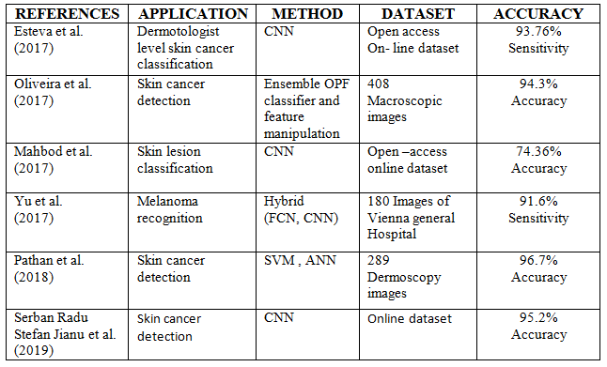
Literature survey

Slide 4
Problem statement
Skin cancer rate has been increasing for past few decades, most of the people didn’t know the seriousness of melanoma
Also, many people who hide their faces and who get feared of medical expenses won’t get proper treatment
Accuracy of the system is still now a problem because the existing system also detects the uncommon diseases with the same threshold

Slide 5
objective
Develop machine learning application that in general, has the ability to:
Determine the affected areas in the image
Determine the disease in specified region
Detect skin cancer in people having varied skin colour
Be applicable locally in Salem
With improved accuracy and performance
Reduce the time consumption during processing

Slide 6
PROPOSED SYSTEM
The complete methodology of our system is represented in a flowchart. The individual steps are modularized and are often autonomous and sometimes dependent on each other
The method we introduced in this application can identify different types of skin cancer
The entire process of project can be perform in four phases. The first process is input and pre-process. In the sample image, the background is brighter in the center than at the bottom of the image
The pre-processing step before analysis, it identify the background uniform and then convert the image into a specific image format. To make the background illumination more accurate
The methods of per-processing inserted between the various-stages of the segmentation, in order to make the latter simpler and more robust
Segmentation of image is used to find objects and boundaries in images
More precisely, segmentation of image is the process of giving a label to every pixel in an image such that pixels with the same label share certain characteristics

Slide 7
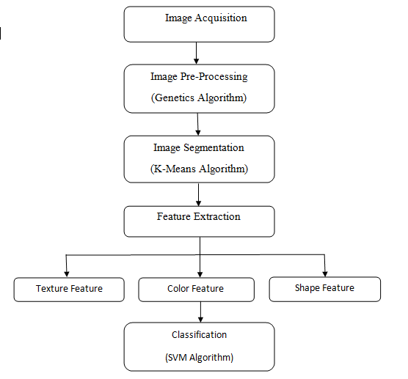
Proposed work

Slide 8
Algorithm GENETICS ALGORITHM
Genetic algorithm (Machine Learning approach) is one of the most important heuristic search techniques from Evolutionary programming languages. The simplest form of genetic algorithm involves three types of operators: Selection, Crossover, Mutation.
Initialize population
Selection
Crossover between selected chromosomes
Perform Mutation
Repeat cycle till the condition of stop is true

Slide 9
K-Means CLUSTERING
K-means clustering is an algorithm to classify or to group the objects based on attributes/features into K number of group
K is positive integer number
The grouping is done by minimizing the sum of squares of distances between data and the corresponding cluster centroid
The simplest unsupervised learning algorithm that solve clustering problem is K- Means algorithm. It is a simple and easy way to classify a given data set through a certain number of clusters

Slide 10
Support vector machine
SVM is a supervised learning algorithm used for regression and classification problems. It is a prediction tool which uses theory of machine learning to maximize accuracy of prediction while automatically avoiding data over fitting.
For a linearly separable case, SVM works by solving the following optimization problem.
SVM performs classification by constructing an N-dimensional hyperplane that optimally separates the data into two categories.
Among the possible hyperplanes, we select the one where the distance of the hyperplane from the closest data points is as large as possible.

Slide 11
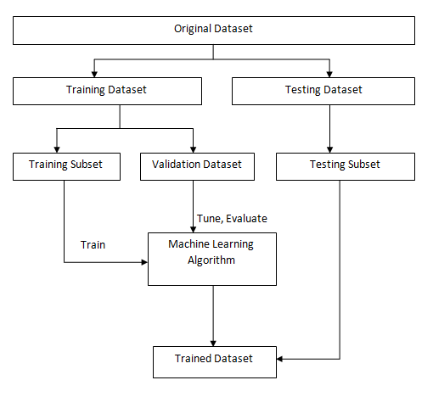
Training and testing dataset

Slide 12
ADVANTAGES
Low computational complexity
Low time complexity
High accuracy for all kinds of skin
Capable to classify different types of skin

Slide 13
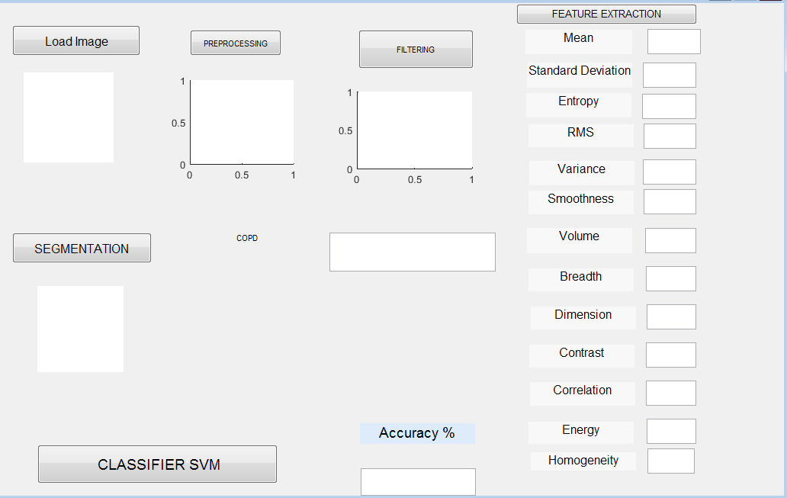
Result simulation output

Slide 14
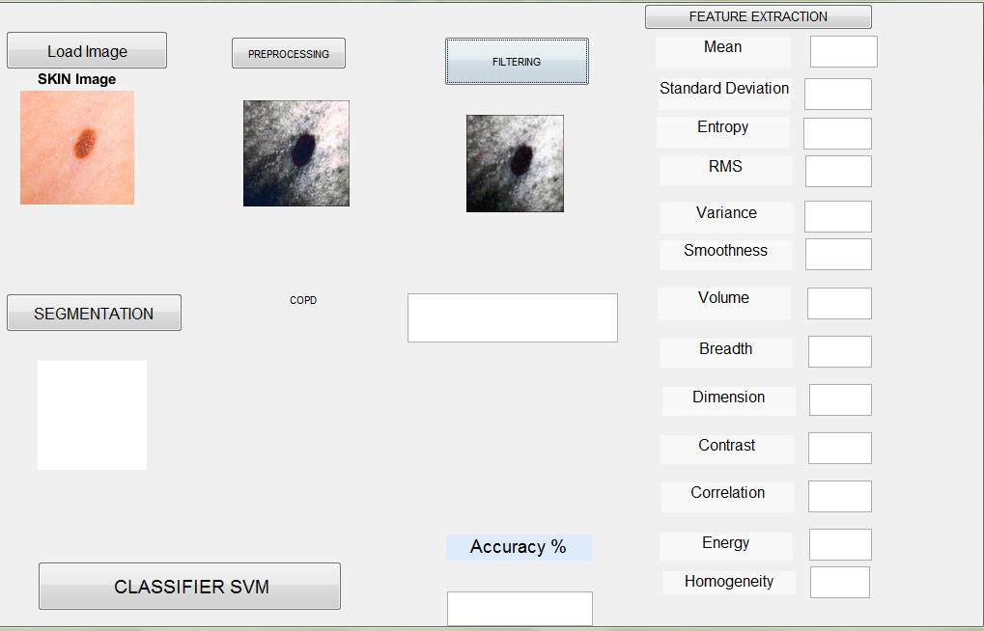
preprocessing

Slide 15
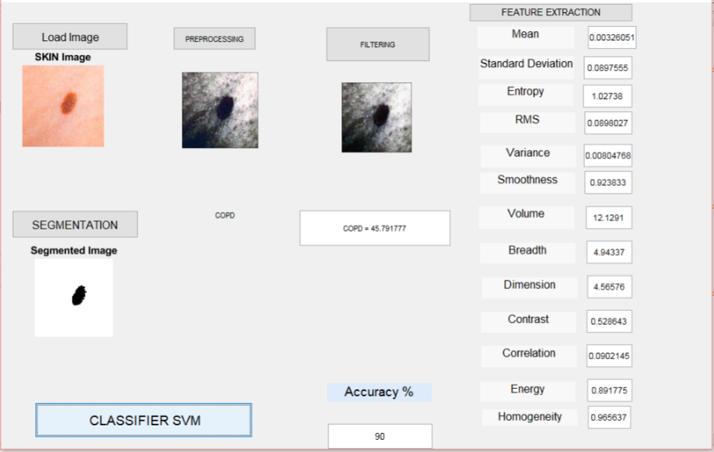
segmentation and feature extraction

Slide 16
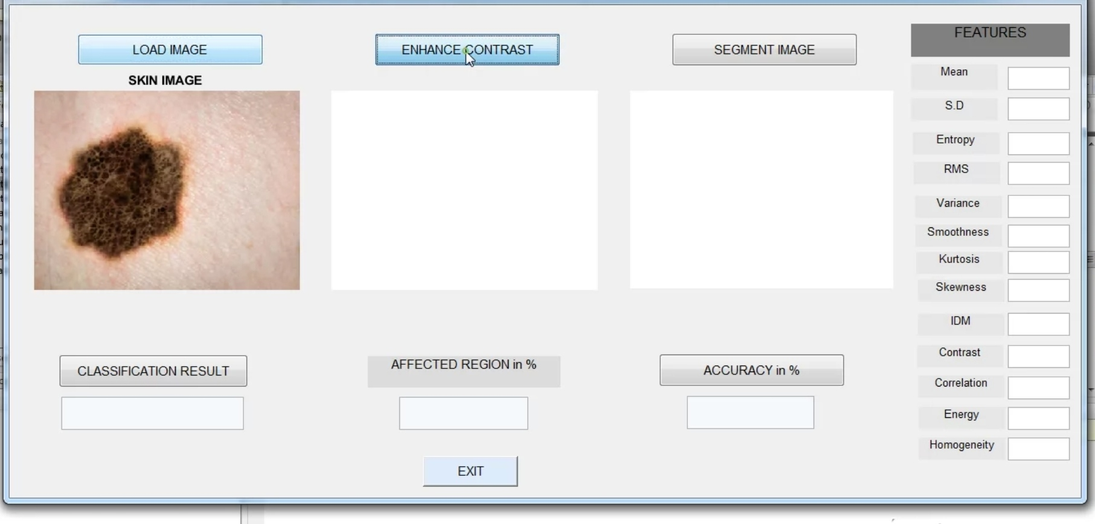
Improved accuracy-modified features

Slide 17
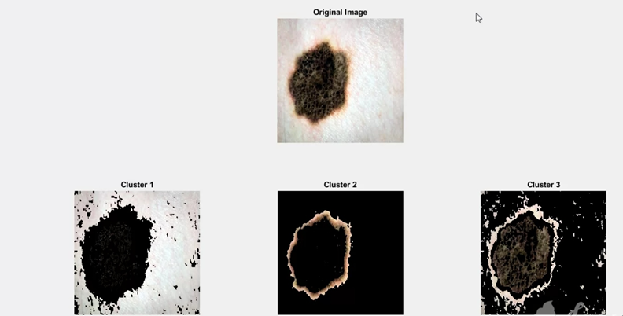
Segmentation of cancerous region

Slide 18
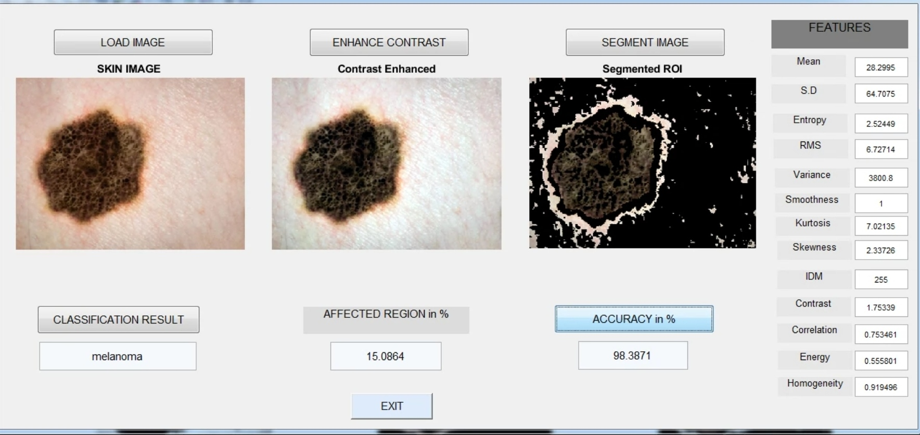
Feature extraction-modified

Slide 19
CONCLUSION
Skin cancer is the major causes of death globally and the early detection of this is very important
The computer aided cancer detection system helps the physician for cancer diagnosis
From the analysis it is examined that, edge detection operator works good for edge detection technique
The automatic detection of cancerous cells in skin possesses various challenges.
The automated system should correctly identify the intended objective at the earliest.
The accuracy of the automated system greatly depends on type of segmentation algorithm employed, the feature to be extracted and the classification methodology incorporated.

Slide 20
REFERENCES
Jyothilakshmi K. K, Jeeva J. B, “Detection of Malignant Skin Diseases Based on the Lesion Segmentation”, International Conference on Communication and Signal Processing, April 3-5, 2014, India
Er. Shrinidhi Gindhi, Ansari Nausheen, Ansari Zoya, Shaikh Ruhin, “An Innovative Approach for Skin Disease Detection Using Image Processing and Data Mining”, International Journal of Innovative Research in Computer and Communication Engineering, Vol. 5, Issue 4, April 2017
A.A.L.C. Amarathunga, E.P.W.C. Ellawala, G.N. Abeysekara, C. R. J. Amalraj, “Expert System for Diagnosis of Skin Diseases”, International Journal of Scientific & Technology Research Volume 4, Issue 01, January 2015
Seema Kolkur, D.R. Kalbande, “Survey of Texture Based Feature Extraction for Skin Disease Detection”, IEEE, 2016

Slide 21
THANK YOU

